Slide 1
Statistical Methods for Data Analysis upper limits examples from real measurements
Luca Lista
INFN Napoli

Slide 2
A rare process limit using event counting and combination of multiple channels
Search for B → τν at BaBar

Slide 3
Upper limits to B → τν at BaBar
Reconstruct one B± with a complete hadronic decay (e⁺e⁻→ ϒ(4S)→B⁺B⁻)
Look for a tau decay on other side with missing energy (neutrinos)
  Five decay channels used: μ⁻νν, e⁻νν, π⁻ν, π⁻π⁰ν, π⁻π⁺π⁻ν
Likelihood function: product of Poissonian likelihoods for the five channels
Background is known with finite uncertainties from side-band applying scaling factors (taken from simulation)
  BABAR Collaboration, Phys.Rev.Lett.95:041804,2005, Search for the Rare Leptonic Decay B⁻ → τ⁻ ν_{τ}

Slide 4
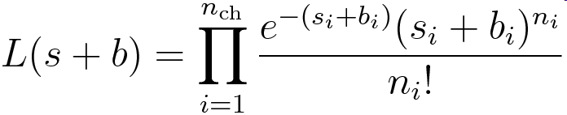
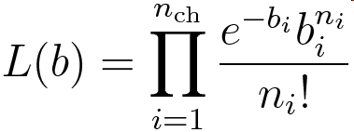
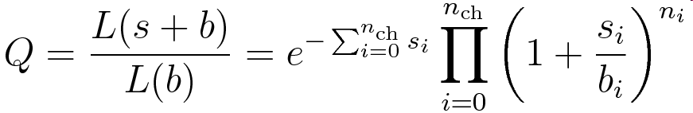
Combined likelihood
Combine the five channels with likelihood (n_{ch} = 5):
Define likelihood ratio estimator, as for combined LEP Higgs search:
In case the scan of −2lnQ vs s shows a significant minimum, a non-null measurement of s can be determined
More discriminating variables may be incorporated in the likelihood definition
Notes:
L(s+b) = \prod_{i=1}^{n_{\mathrm{ch}}}\frac{e^{-(s_i+b_i)}(s_i+b_i)^{n_i}}{n_i!}
L(b) = \prod_{i=1}^{n_{\mathrm{ch}}}\frac{e^{-b_i}b_i^{n_i}}{n_i!}
Q = \frac{L(s+b)}{L(b)} = e^{-\sum_{i=0}^{n_{\mathrm{ch}}}s_i}\prod_{i=0}^{n_{\mathrm{ch}}}\left(1+\frac{s_i}{b_i}\right)^{n_i}

Slide 5
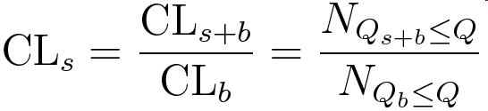
Upper limit evaluation
Use toy Monte Carlo to generate a large number of counting experiments
Evaluate the C.L. for a signal hypothesis defined as the fraction of C.L. for the s+b and b hypotheses:
Modified frequentist approach
Notes:
\mathrm{CL}_s = \frac{\mathrm{CL}_{s+b}}{\mathrm{CL}_b} = \frac{N_{Q_{s+b}\le Q}}{N_{Q_{b}\le Q}}

Slide 6
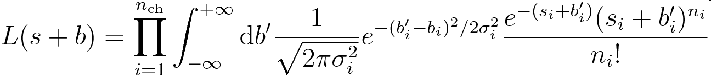
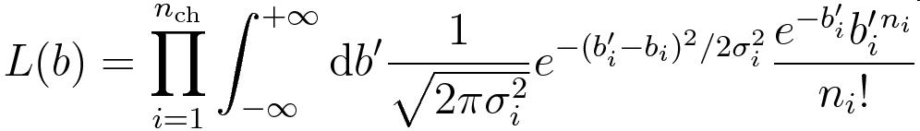
Including (Gaussian) uncertainties
Nuisance parameters are the background yields b_{i} known with some uncertainty from side-band extrapolation
Convolve likelihood with a Gaussian PDF (assuming negligible the tails at negative yield values!)
  Note: b_{i} is the estimated background, not the “true” one!
… but C.L. evaluated anyway with a frequentist approach (Toy Monte Carlo)!
Analytical integrability leads to huge CPU saving!
(L.L., A 517 (2004) 360–363)
Notes:
L(s+b) = \prod_{i=1}^{n_{\mathrm{ch}}}\int_{-\infty}^{+\infty}\mathrm{d}b^\prime\frac{1}{\sqrt{2\pi\sigma_i^2}}e^{-(b^\prime_i-b_i)^2/2\sigma_i^2}\frac{e^{-(s_i+b^\prime_i)}(s_i+b^\prime_i)^{n_i}}{n_i!}
L(b) = \prod_{i=1}^{n_{\mathrm{ch}}}\int_{-\infty}^{+\infty}\mathrm{d}b^\prime\frac{1}{\sqrt{2\pi\sigma_i^2}}e^{-(b^\prime_i-b_i)^2/2\sigma_i^2}\frac{e^{-b^\prime_i}b^\prime_i^{n_i}}{n_i!}

Slide 7
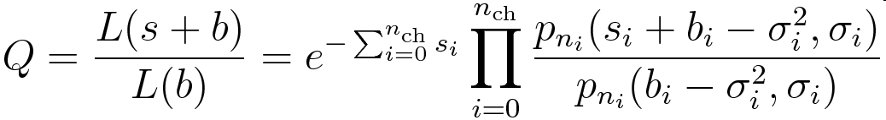
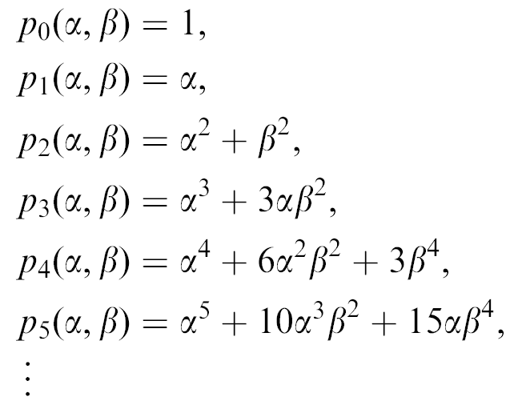
Analytical expression
Simplified analytic Q derivation:
Where p_{n}(α, β) are
polynomials defined with
a recursive relation:
… but in many cases it’s hard to be so lucky!
Notes:
Q = \frac{L(s+b)}{L(b)} = e^{-\sum_{i=0}^{n_{\mathrm{ch}}}s_i}\prod_{i=0}^{n_{\mathrm{ch}}}\frac{p_{n_i}(s_i+b_i-\sigma_i^2, \sigma_i)}{p_{n_i}(b_i-\sigma_i^2, \sigma_i)}
p_n(\alpha,\beta) = \alpha p_{n-1}(\alpha,\beta)+(n+1)\beta^2p_{n-2}(\alpha,\beta)

Slide 8
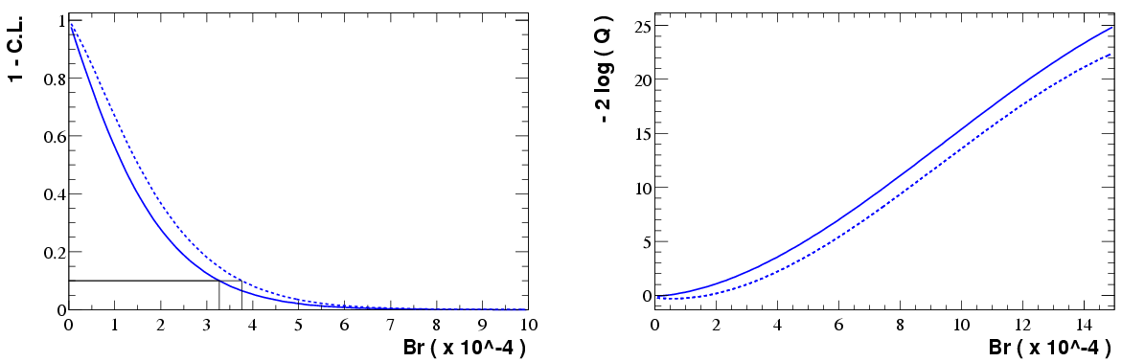
Branching ratio: ∫Ldt = 82 fb⁻¹
Low statistics scenario
No evidence for
a local minumum
Without background
uncertainty
With background
uncertainty
without
with uncertainty
without
with uncertainty
RooStats::HypoTestInverter

Slide 9
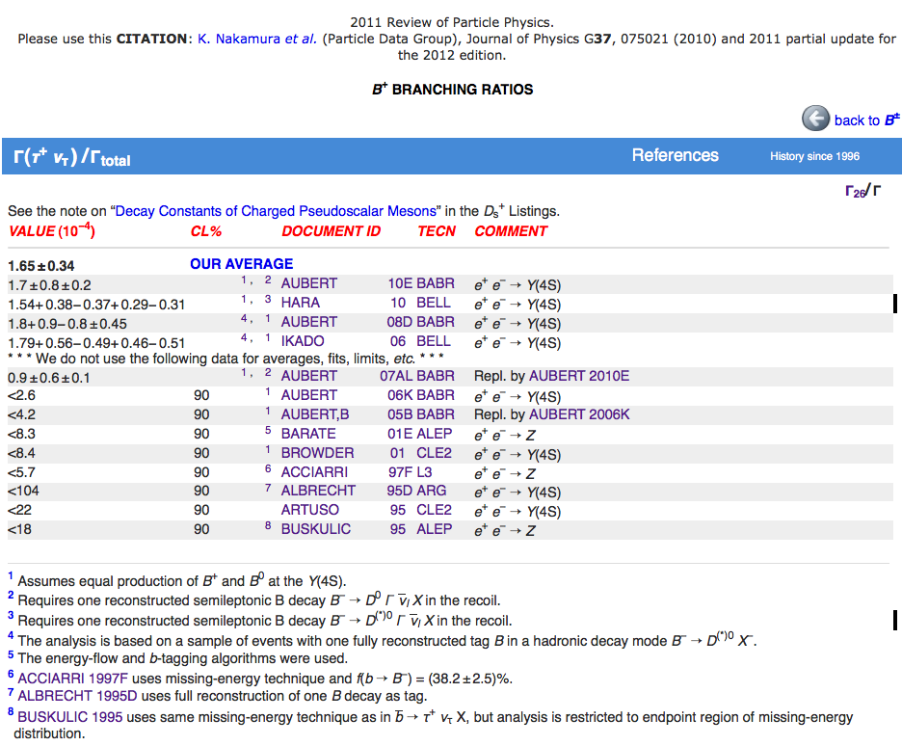
B → τν was eventually measured
… and is now part of the PDG

Slide 10
A Bayesian approach to Higgs search with small background
Higgs search at LEP-I (L3)

Slide 11
Higgs search at LEP
Production via e⁺e⁻→HZ* →bbl⁺l⁻
Higgs candidate mass measured via missing mass to lepton pair
Most of the background rejected via kinematic cuts and isolation requirements for the lepton pair
Search mainly dominated by statistics
A few background events survived selection (first observed in L3 at LEP-I)

Slide 12
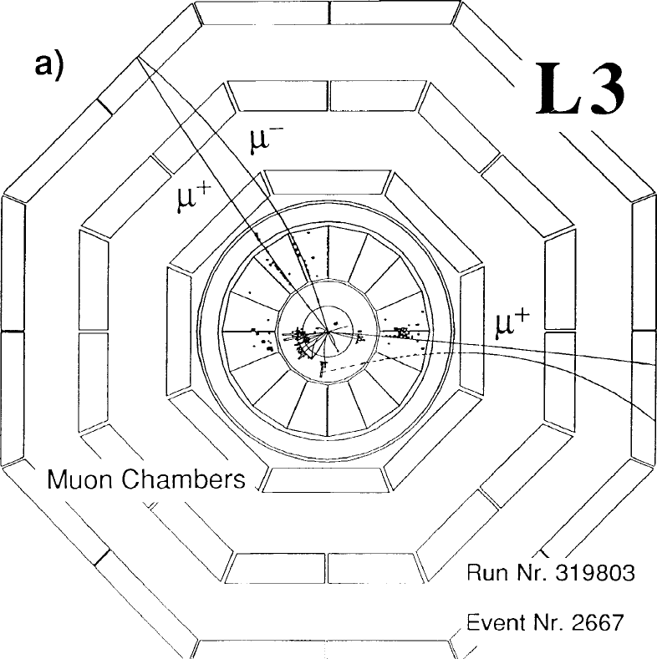
First Higgs candidate (m_{H}≅70 GeV)

Slide 13
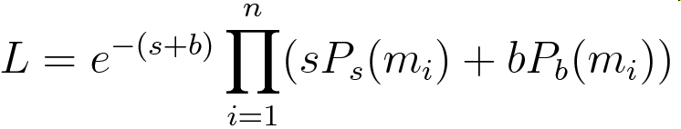
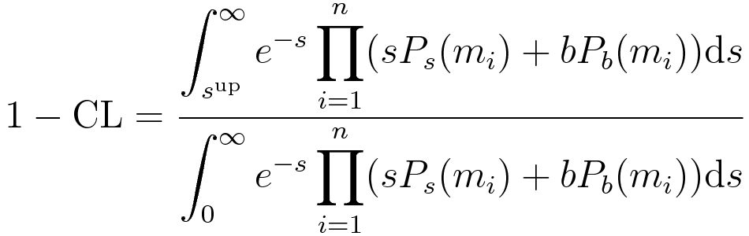
Extended likelihood approach
Assume both signal and background are present, with different PDF for mass distribution: Gaussian peak for signal, flat for background (from Monte Carlo samples):
Bayesian approach can be used to extract the upper limit, with uniform prior, π(s) = 1:
Notes:
L = e^{-(s+b)}\prod_{i=1}^n(sP_s(m_i)+bP_b(m_i))
1-\mathrm{C.L.} = \frac{\displaystyle\int_{s^{\mathrm{up}}}^\infty e^{-s}\prod_{i=1}^n(sP_s(m_i)+bP_b(m_i))\mathrm{d}s}{\displaystyle\int_0^\infty e^{-s}\prod_{i=1}^n(sP_s(m_i)+bP_b(m_i))\mathrm{d}s}

Slide 14
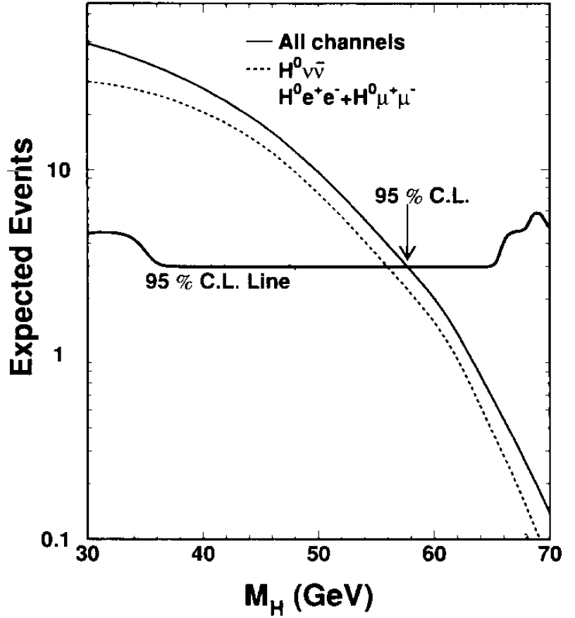
Application to Higgs search at L3
LEP-I
3 events
“standard” limit
31.4 ±1.5
67.6 ± 0.7
70.4 ± 0.7

Slide 15
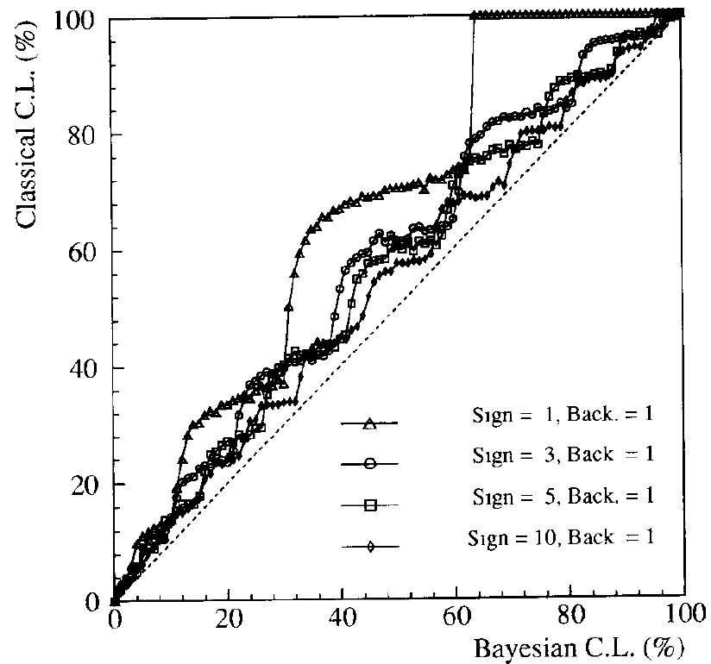
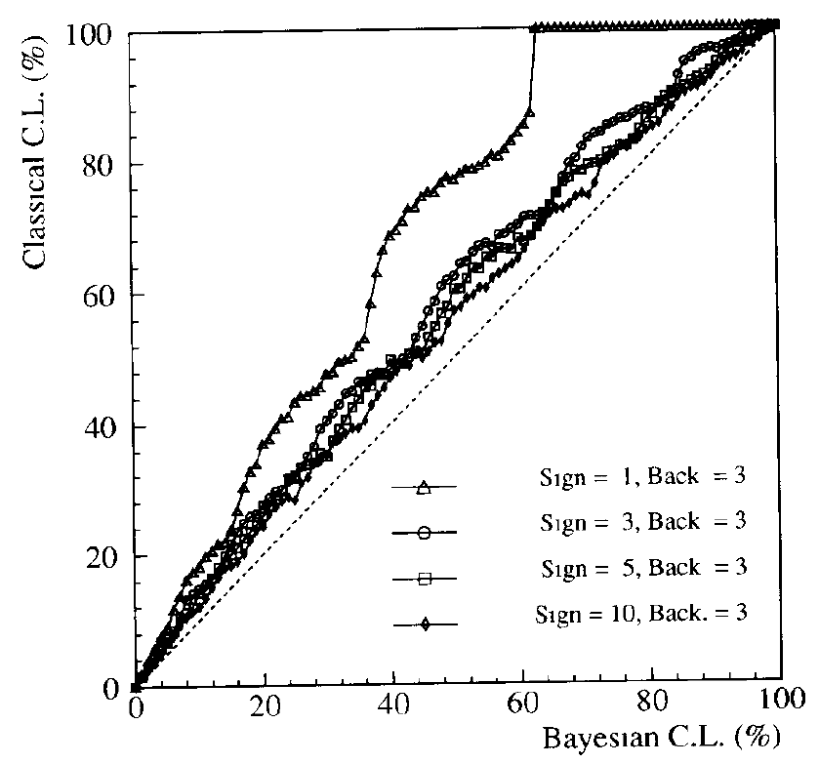
Comparison with frequentist C.L.
Toy MC can be generated for different signal and background scenarios
frequentist coverage (“classical” CL) can be computed counting the fraction of toy experiments above/below the Bayesian limit
Always
conservative!

Slide 16
Higgs search at LEP-II
Combined search using CLs

Slide 17
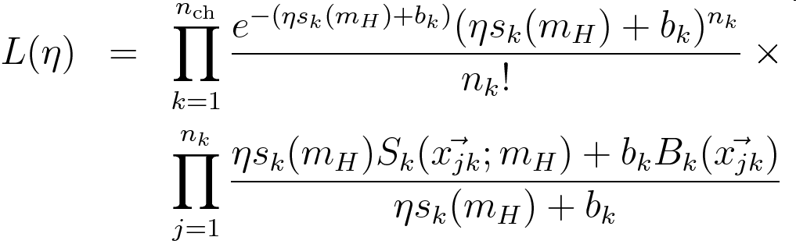
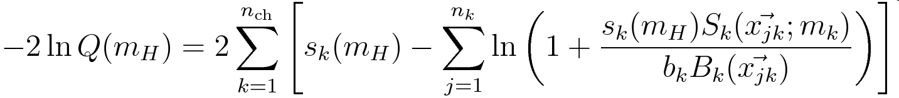
Combined Higgs search at LEP-II
Extended likelihood definition:
η = 0 for b only, 1 for s + b hypotheses
Likelihood ratio:
Notes:
L(\eta) & = & \prod_{k=1}^{n_{\mathrm{ch}}}\frac{e^{-(\eta s_k(m_H)+b_k)}(\eta s_k(m_H)+b_k)^{n_k}}{n_k!}\times \\ & & \prod_{j=1}^{n_k}\frac{\eta s_k(m_H)S_k(\vec{x_{jk}};m_H)+b_k B_k(\vec{x_{jk}})}{\eta s_k(m_H)+b_k}
-2\ln Q(m_H) = 2 \sum_{k=1}^{n_{\mathrm{ch}}}\left[s_k(m_H) - \sum_{j=1}^{n_k}\ln\left(1+\frac{s_k(m_H)S_k(\vec{x_{jk}};m_k)}{b_k B_k(\vec{x_{jk}})} \right) \right]

Slide 18
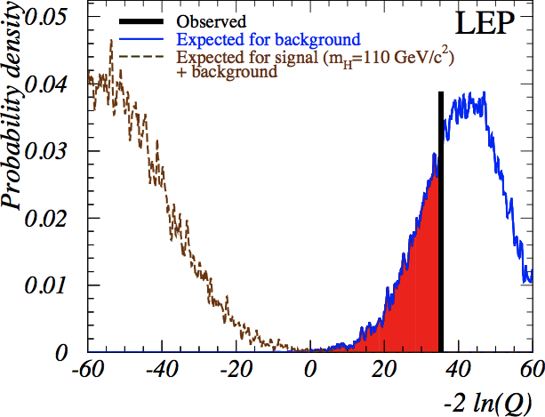
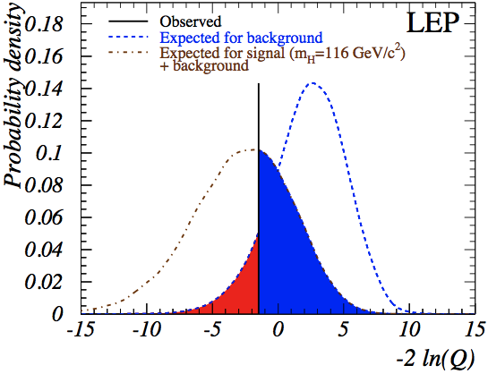
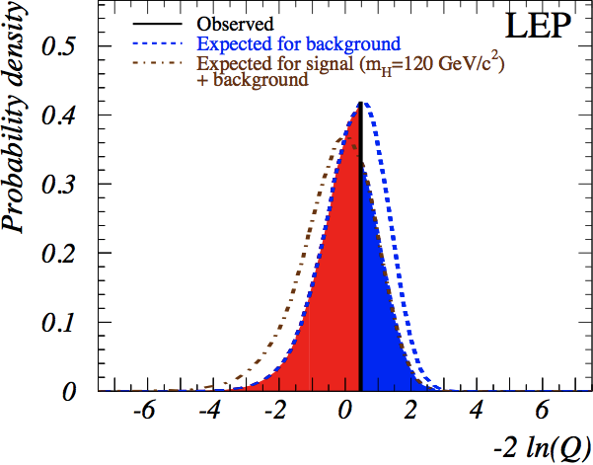
CLs PDF plot

Slide 19

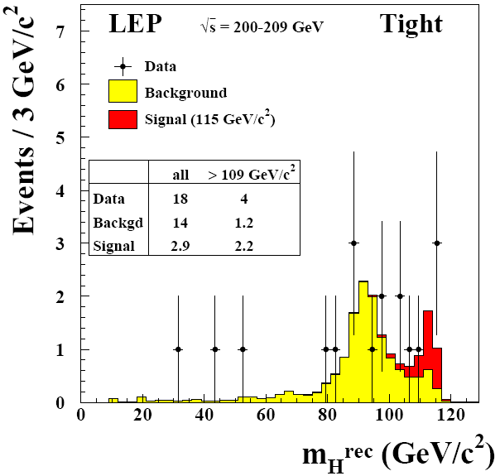
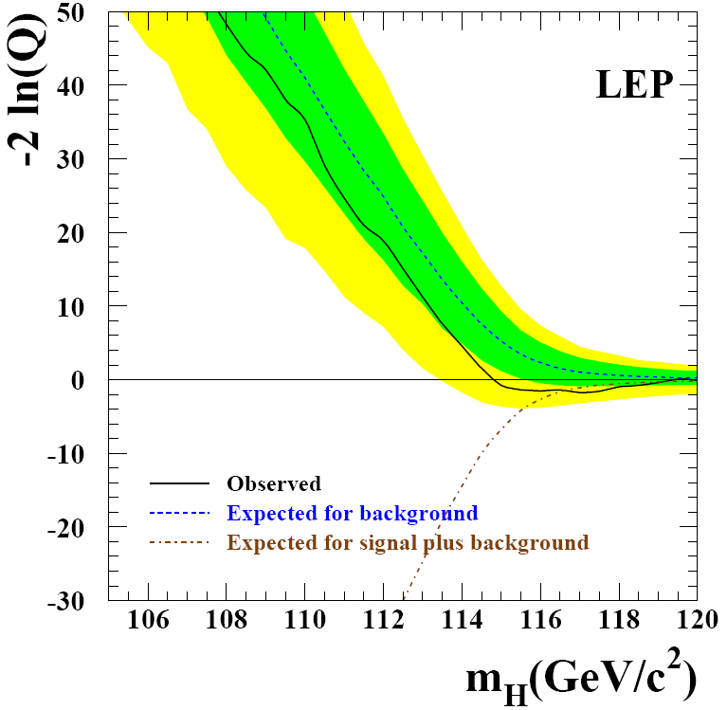
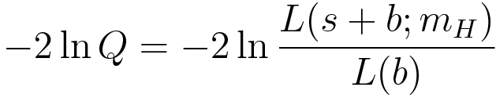
Mass scan plot
Bkg only (sim.)
Observed (data)
Green: 68%
Yellow: 95%
Signal + bkg (sim.)

Slide 20
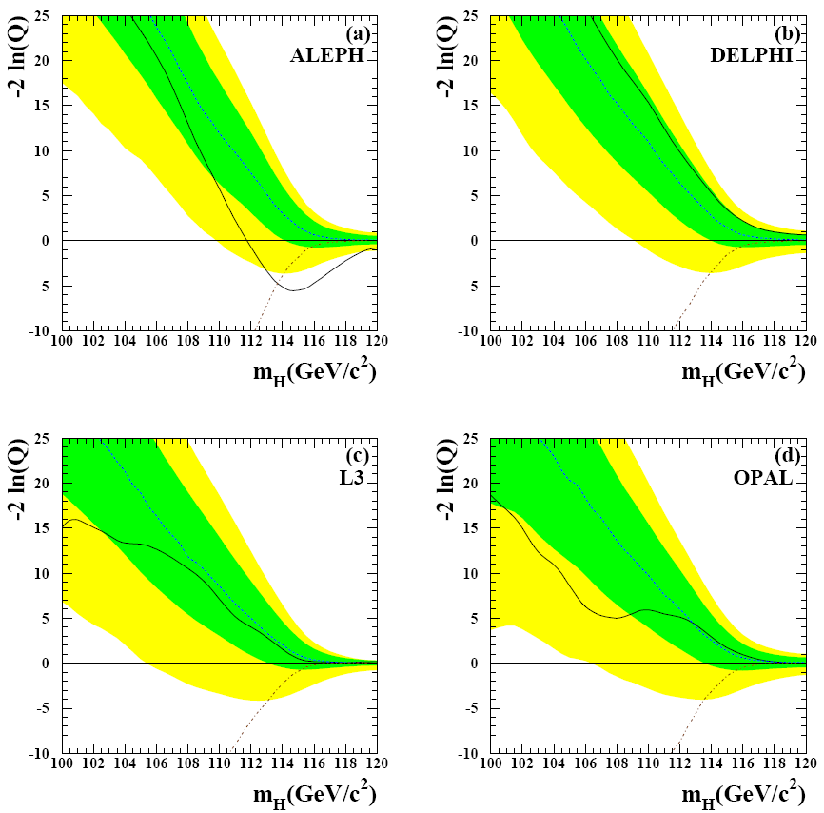
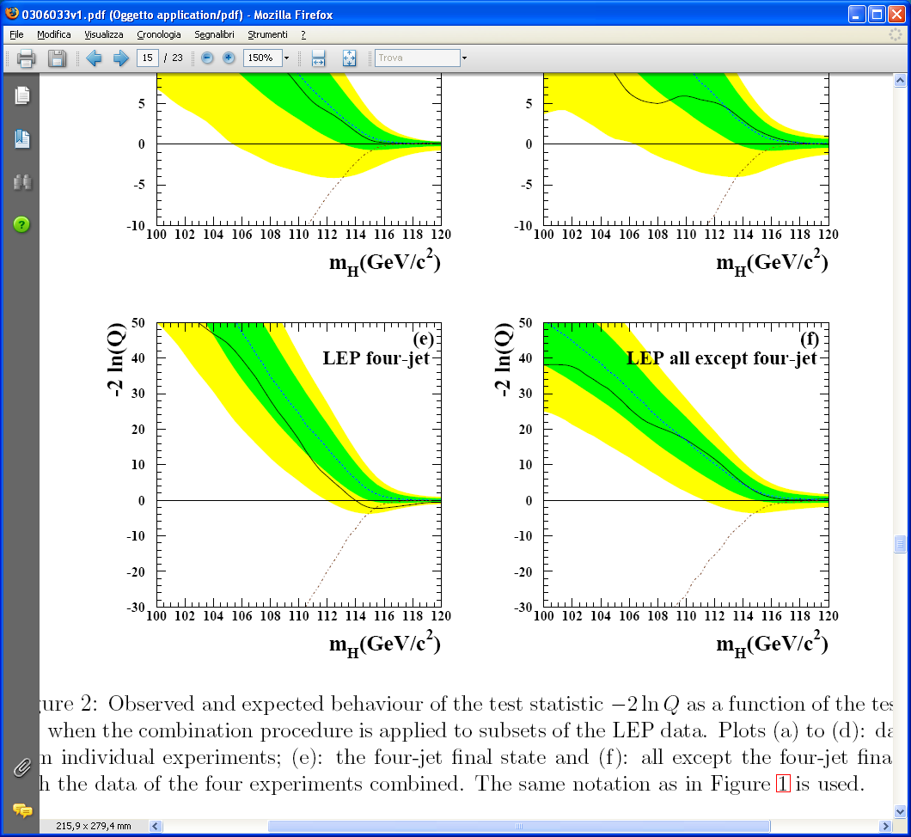
By experiment & channel

Slide 21
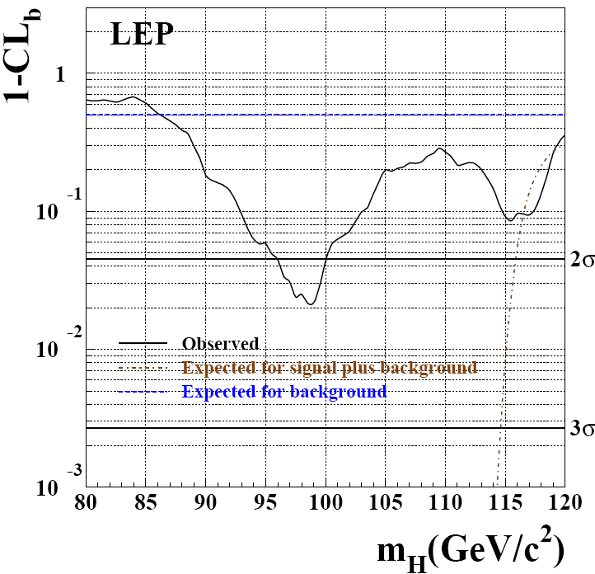
Background hypothesis C.L.

Slide 22
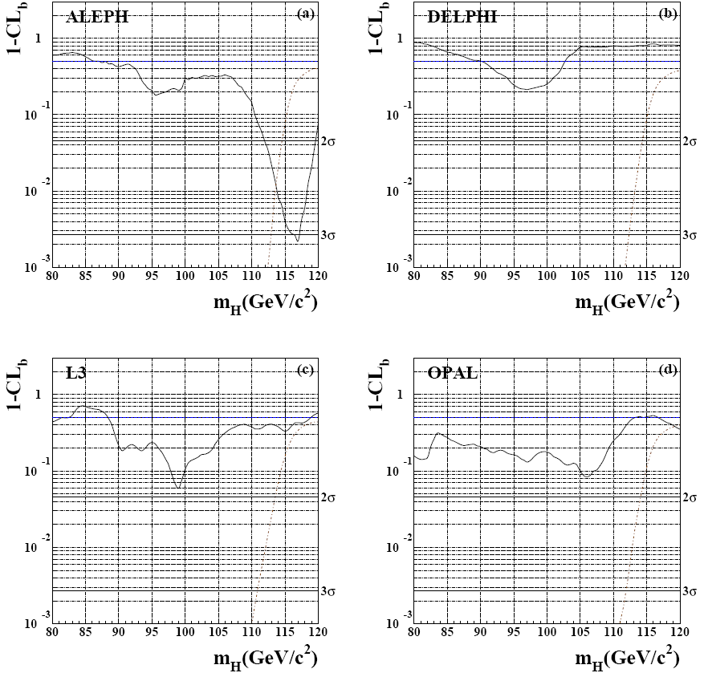
Background C.L. by experiment

Slide 23
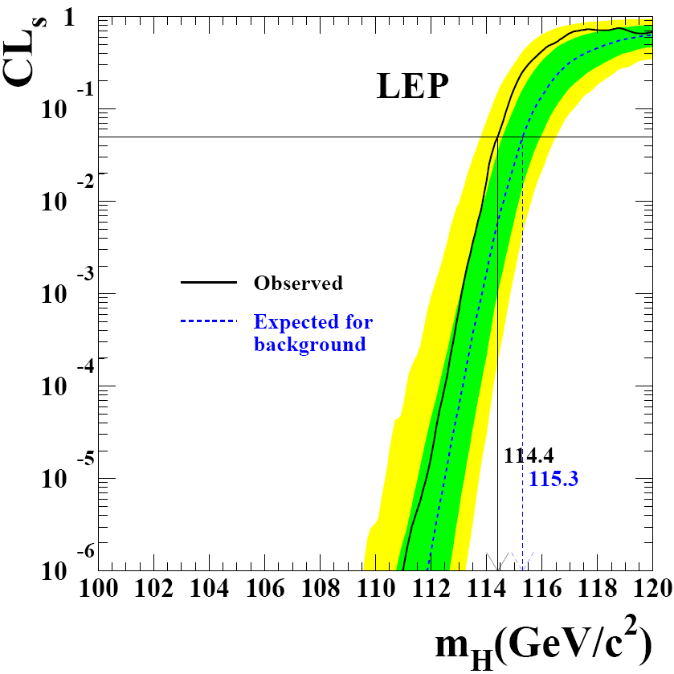
Signal hypothesis C.L.

Slide 24
Higgs search at LHC
Combined search using CLs
Luca Lista
Statistical methods in LHC data analysis
24

Slide 25
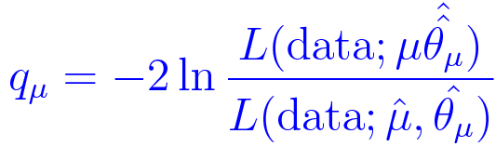
Higgs search at LHC method
Agreed method between ATLAS and CLS
Test statistics:
Has good asymptotic behavior
Nuisance parameters are profiled
Uncertainties are modeled with log-normal PDFs
CLs protects against unphysical limits in cases of large downward background fluctuations
Observed and median expected values of CLs limits presented as 68% and 95% belts

Slide 26
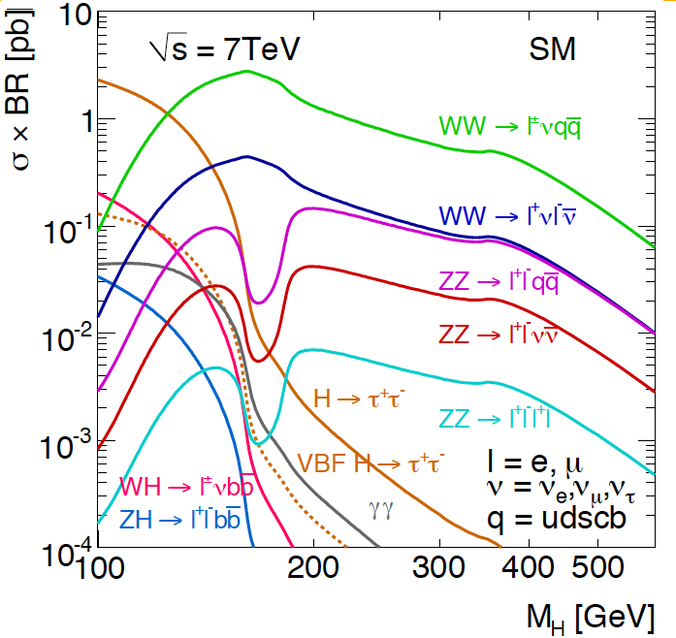
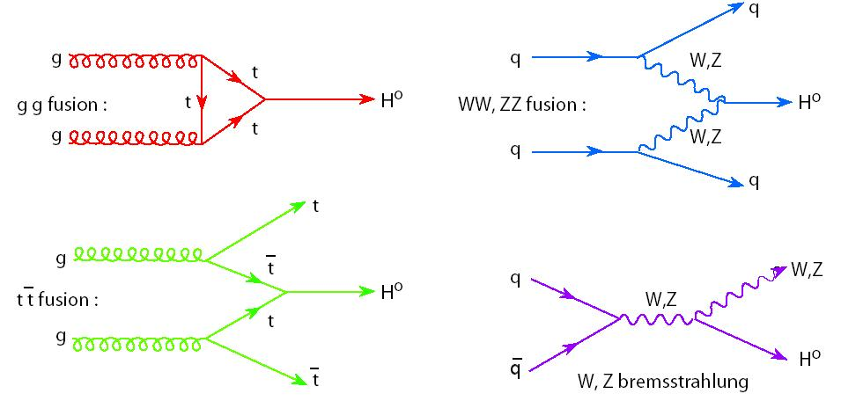
Higgs boson production at LHC
Decays are favored into heavy particles
(top, Z, W, b, …)
Most abundant
production via
“gluon fusion” and
“vector-boson fusion”

Slide 27
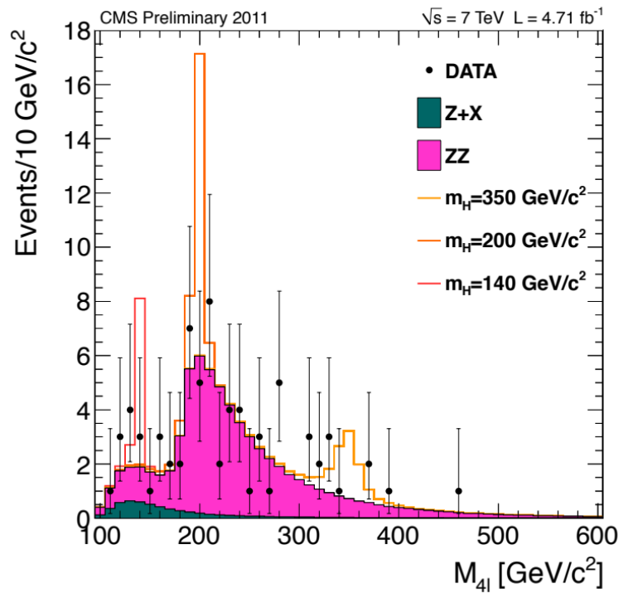
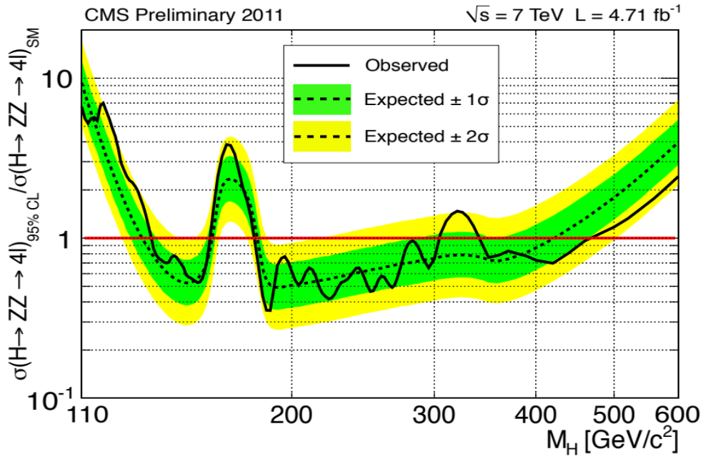
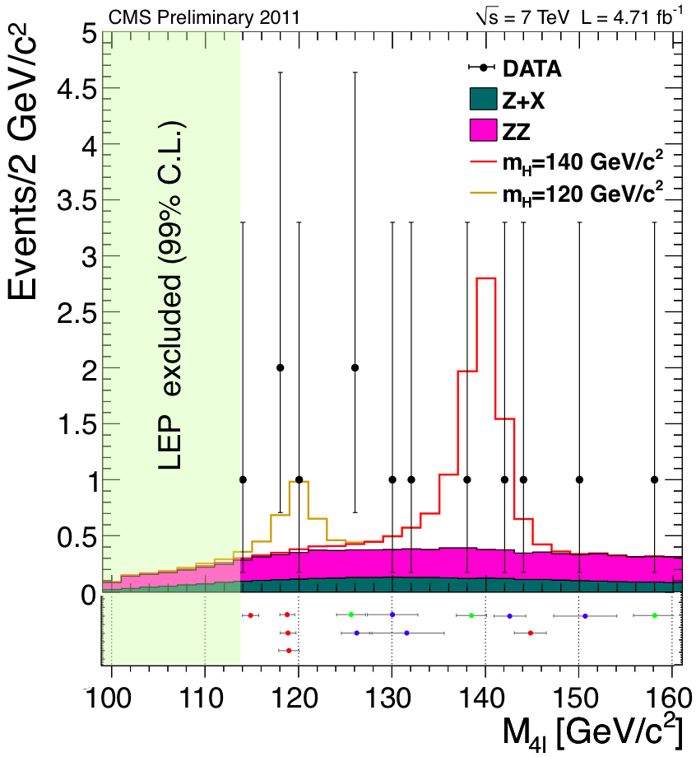
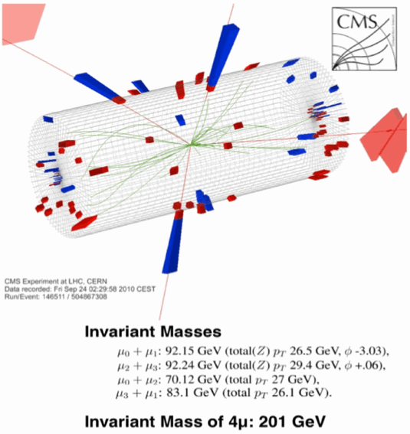
“Golden” channel: H→ZZ →4l (l=e,μ)
Mass resolution is
~2-3 GeV

Slide 28
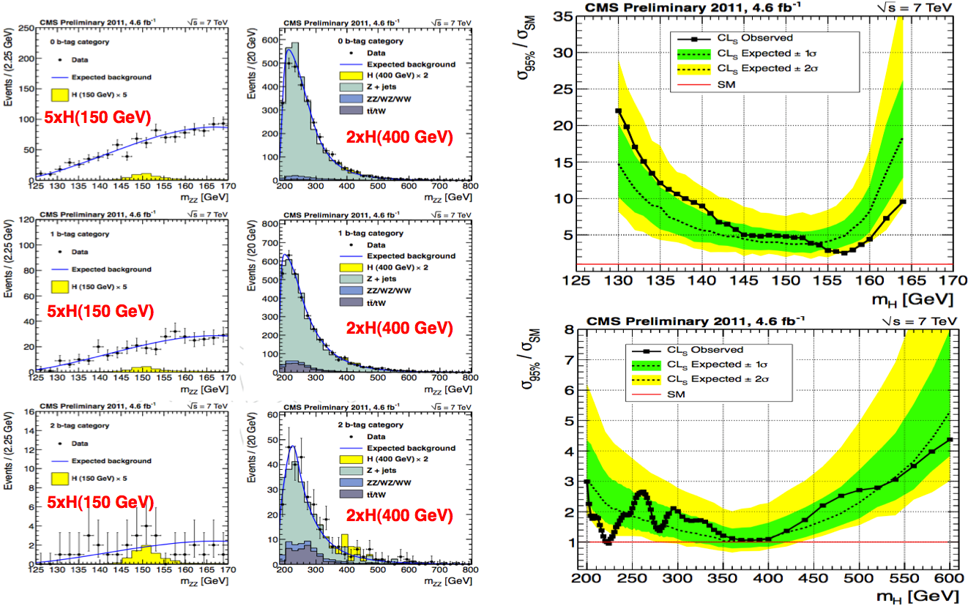
Jets: H→ZZ→2l2q (l=e,μ)

Slide 29
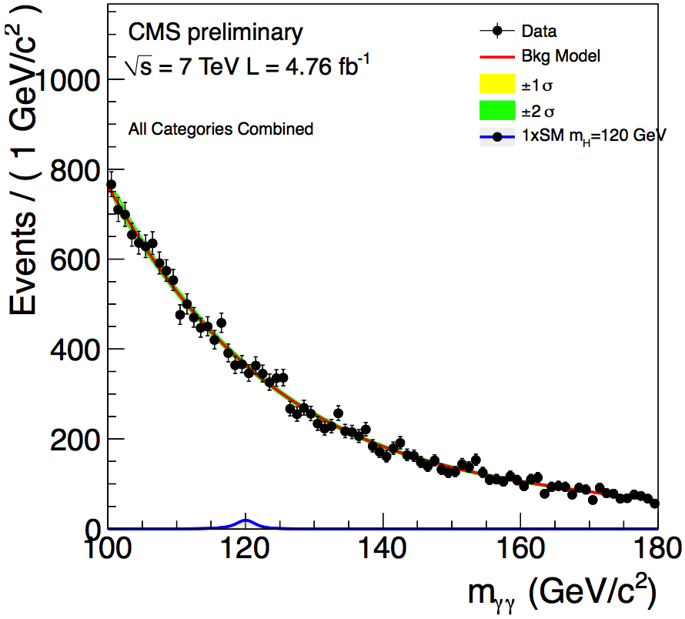
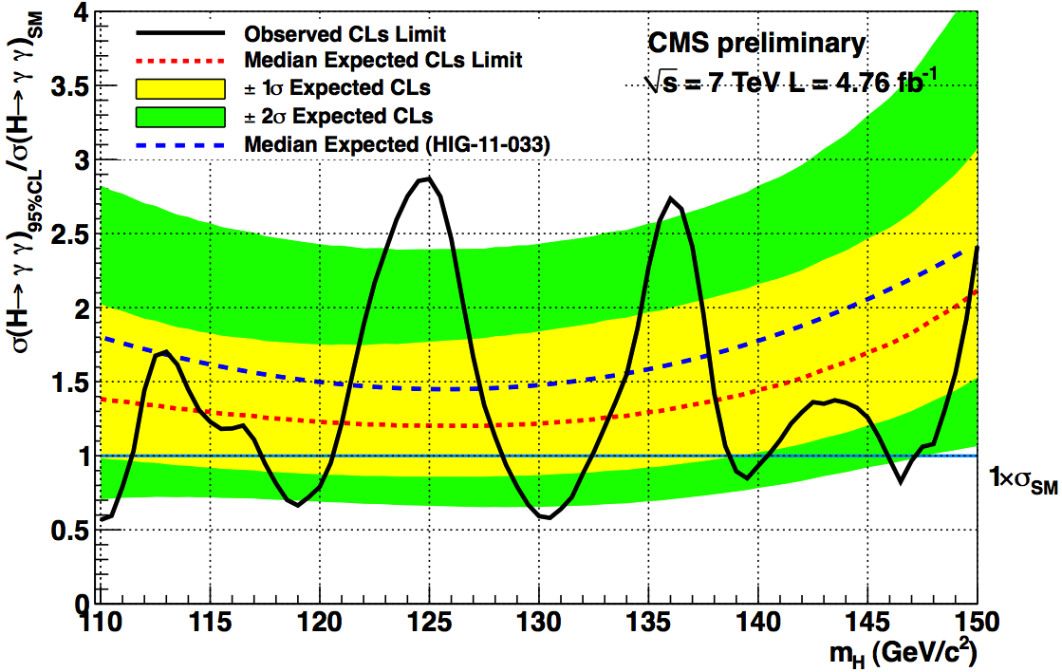
H→γγ
Large background, good resolution

Slide 30
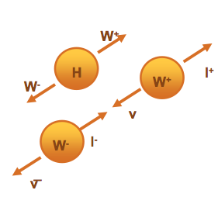
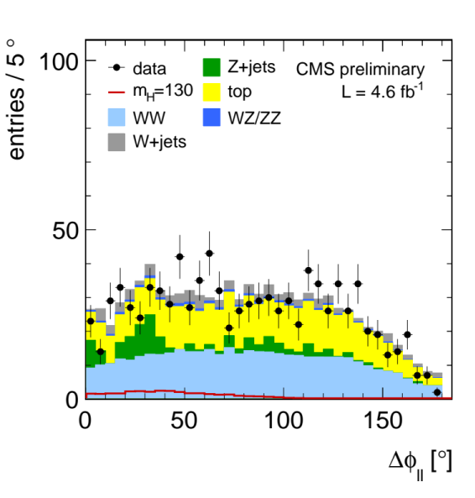
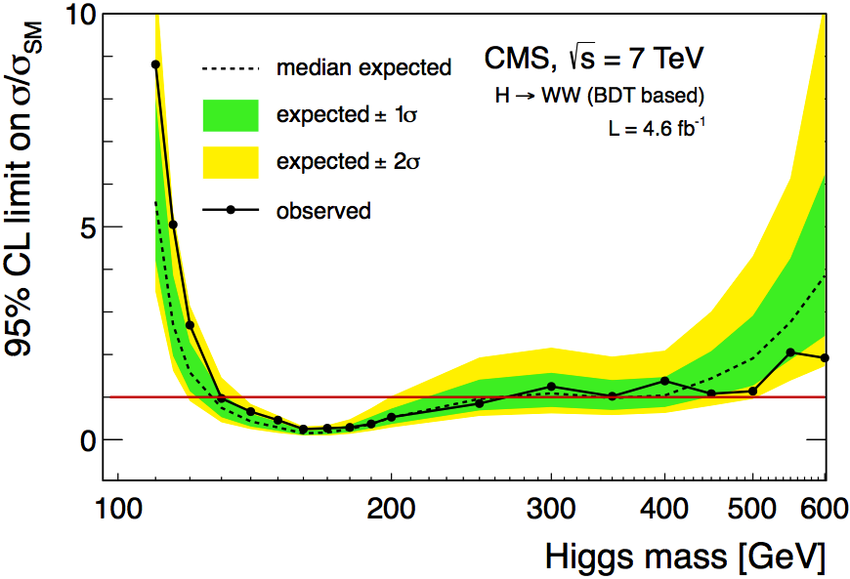
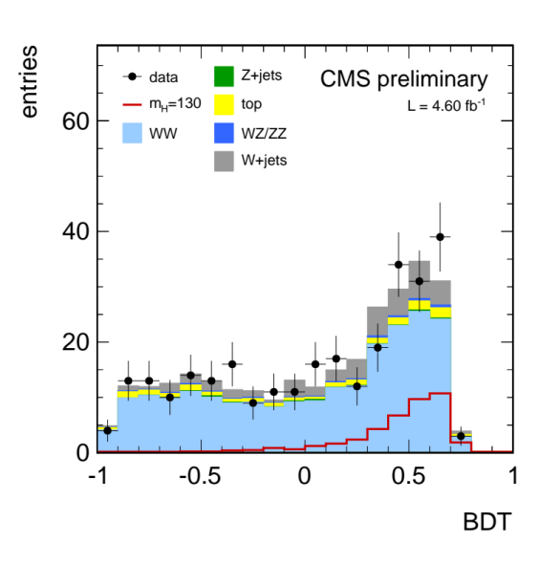
H→WW→2l2ν
Can’t reconstruct Higgs mass due to neutrinos
Signal can be discriminated vs background using
angular distribution (Higgs boson has spin zero)
  Two leptons tend to be aligned in Higgs event
A multivariate analysis maximizes sig/bkg
separation
Boosted Decision Tree

Slide 31
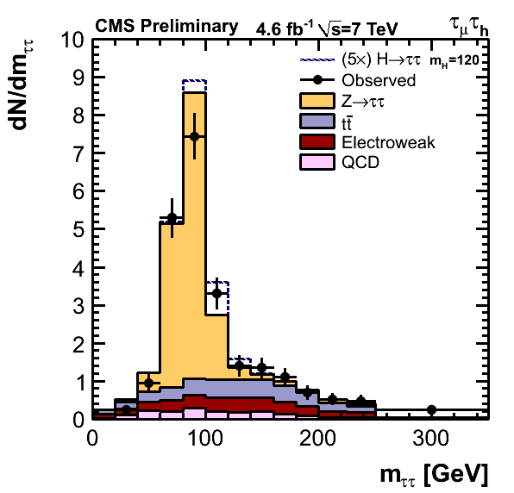
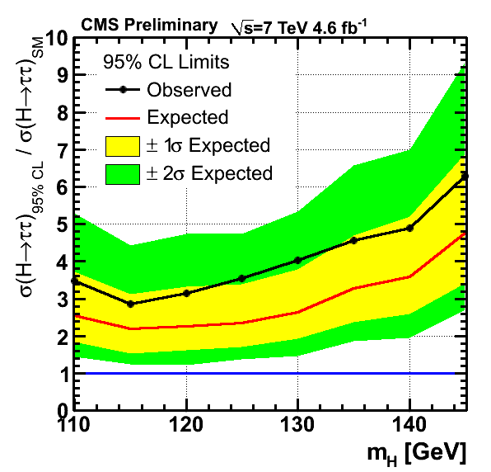
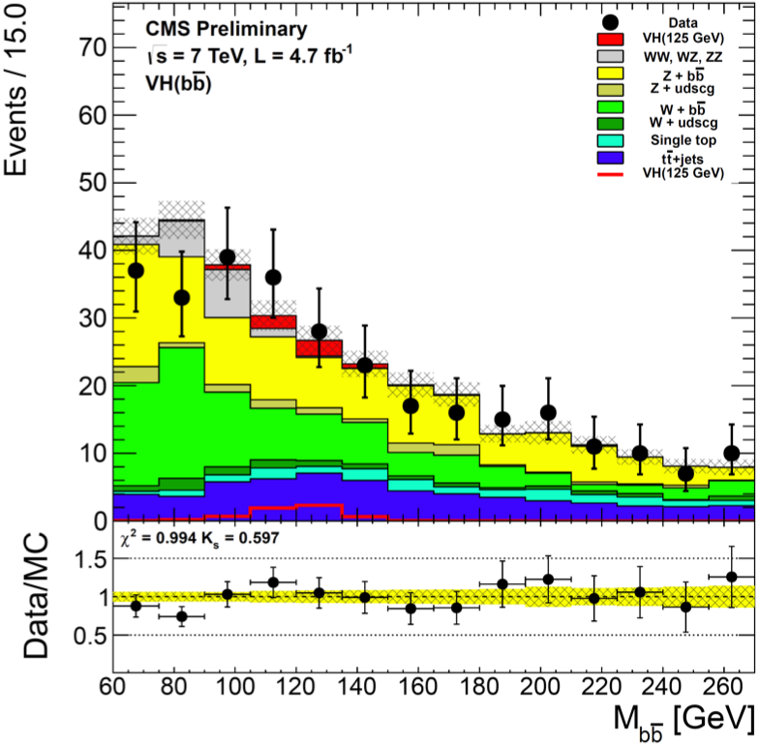
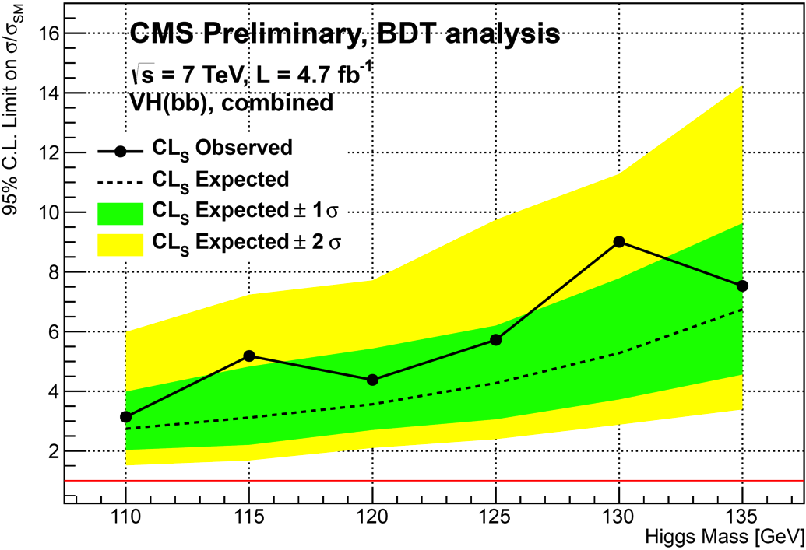
Low mass sensitive channels
ττ
bb

Slide 32
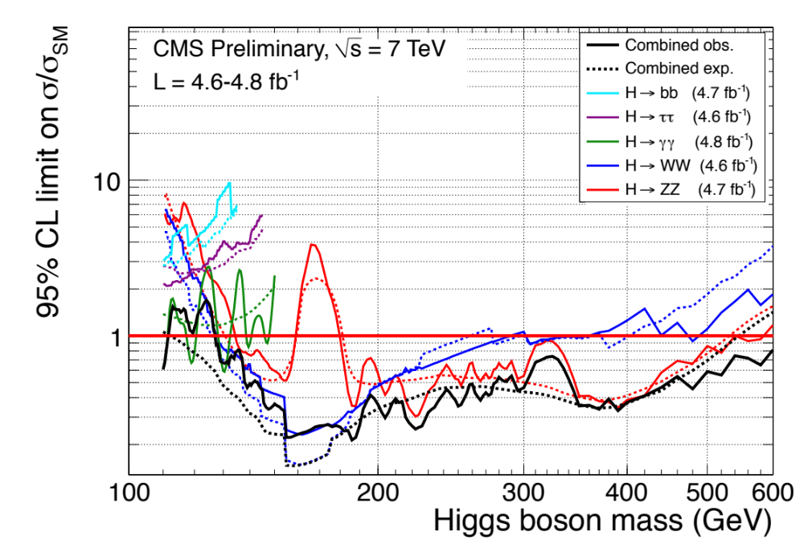
Combining limits to σ/σSM
Phys. Lett. B 710 (2012) 26-48, arXiv:1202.1488
Excluded range: 127.5–600 GeV al 95% CL (expected: 114.5-543 GeV)

Slide 33
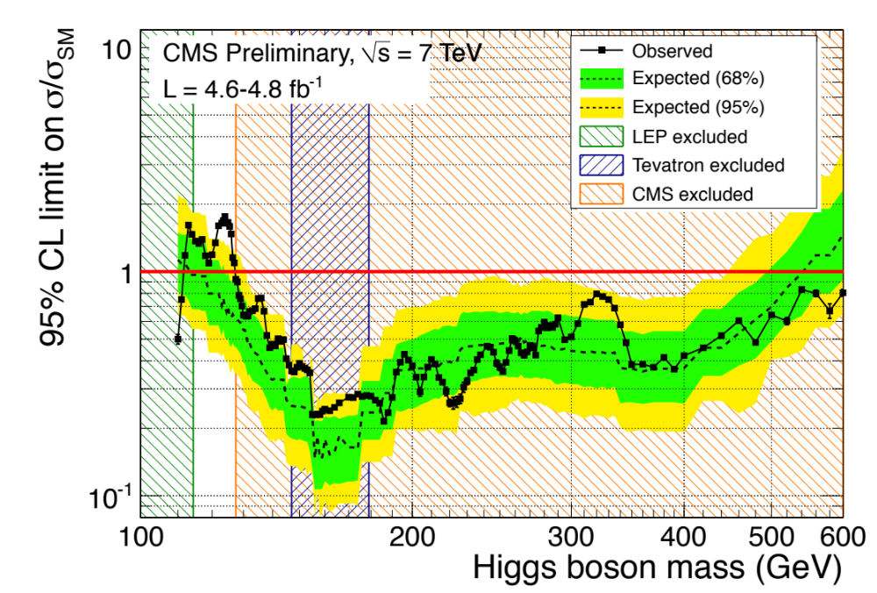
Exclusion plot at 95% CL

Slide 34
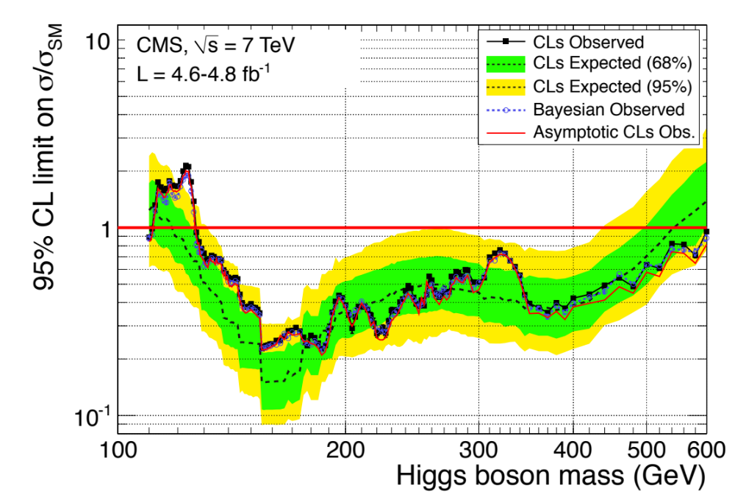
CL_{s} vs Bayesian and asymptotic

Slide 35

What if we use 99%?
Excluded range: 127.5–600 GeV at 95% CL, 129–525 GeV at 99% CL

Slide 36


Cross section “measurement”
±1σ = excursion of +1 of likelihood from best fit value

Slide 37


Comparing different channels
Best fit to σ/σ_{SM} separately in various canals
A modest excess is present consistently in all low-mass sensitive channels

Slide 38


“Hint” or fluctuation?
Probability of a bkg fluctuation ≥ than the observed one
The global significance of the observed maximum excess (minimum local p-value) for the full combination in this mass range is about 2.1σ, estimated using pseudoexperiments

Slide 39
“Hint” or fluctuation?
Probability of a bkg fluctuation ≥ than the observed one
Note once again:
p-value is the probability to have at least the observed fluctuation if we have only background,
Not
Probability to have only background given the observed fluctuation!
The global significance of the observed maximum excess (minimum local p-value) for the full combination in this mass range is about 2.1σ, estimated using pseudoexperiments

Slide 40


ATLAS: γγ, 4l
arXiv:1202.1414 arXiv:1202.1415

Slide 41


ATLAS: combined limit
arXiv:1202.1408
ATLAS-CONF-2012-019
Local sifnificance: 2.8σ (γγ), 2.1σ (ZZ*→4l), 1.4σ (WW*→lνlν)
Global significance (LEE) 2.2σ (110-600 GeV)
Excluded ranges: (95% CL):110–115.5 GeV, 118.5-122.5 GeV, 129–539GeV
(expected: 120–550 GeV)

Slide 42


ATLAS
“cross section”

Slide 43

Latest from Tevatron
arXiv:1203.3774
Excluded ranges: 100-107 GeV, 147-179, expected: 100-119 GeV, 141-184 GeV
Local significance (120 GeV): 2.7σ, global significance (LEE); 2.2σ

Slide 44

SM fit

Slide 45
In conclusion
Many recipes and approaches available
Bayesian and Frequentist approaches lead to similar results in the easiest cases, but may diverge in frontier cases
Be ready to master both approaches!
… and remember that Bayesian and Frequentist limits have very different meanings
If you want your paper to be approved soon:
  Be consistent with your assumptions
  Understand the meaning of what you are computing
  Try to adopt a popular and consolidated approach (even better, software tools, like RooStats), wherever possible
  Debate your preferred statistical technique in a statistics forum, not a physics result publication!

